Slide 1
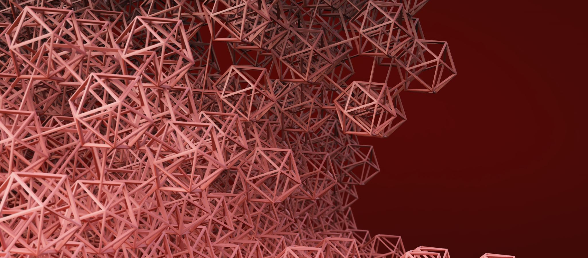
ABM Topics Meeting
Zehao Qian
zehao.qian.cn@gmail.com

Slide 2
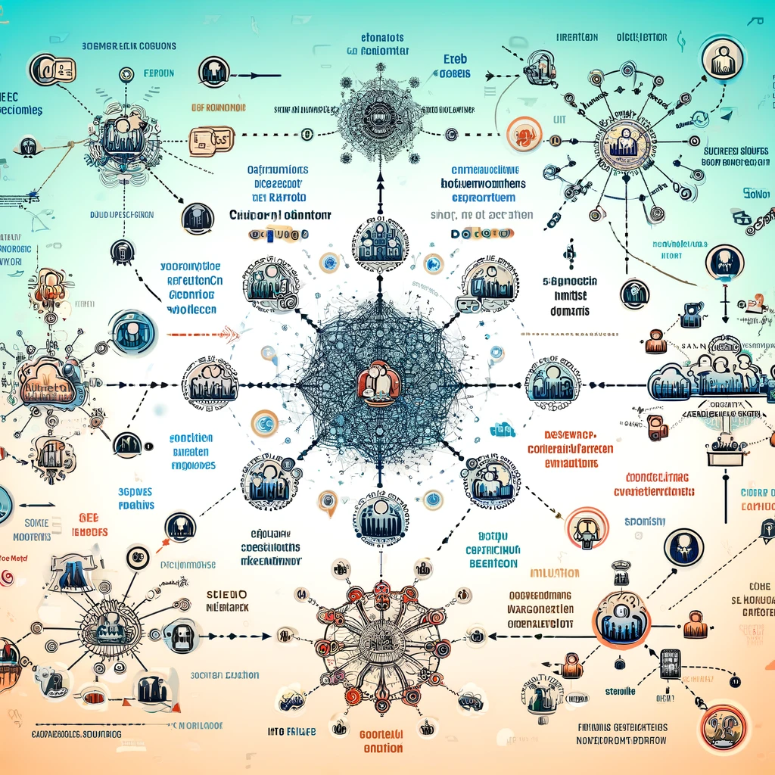
Main Direction
Opinion dynamics in social networks
Study of the formation and evolution of opinions among different social groups.
Simulate the influence of opinion leaders on public opinions with ABM, as well as the influence of different social network structures (such as small-world networks, scale-free networks) on the spread of opinions.
Use large language models to analyze and generate discussions on specific topics and observe changes in opinions.

Slide 3
Topics
Topic 1 Market Acceptance of a New Technology Product
Topic 2 Social Movements and Protests
Topic 3 Discussions on Social Welfare Policies

Slide 4
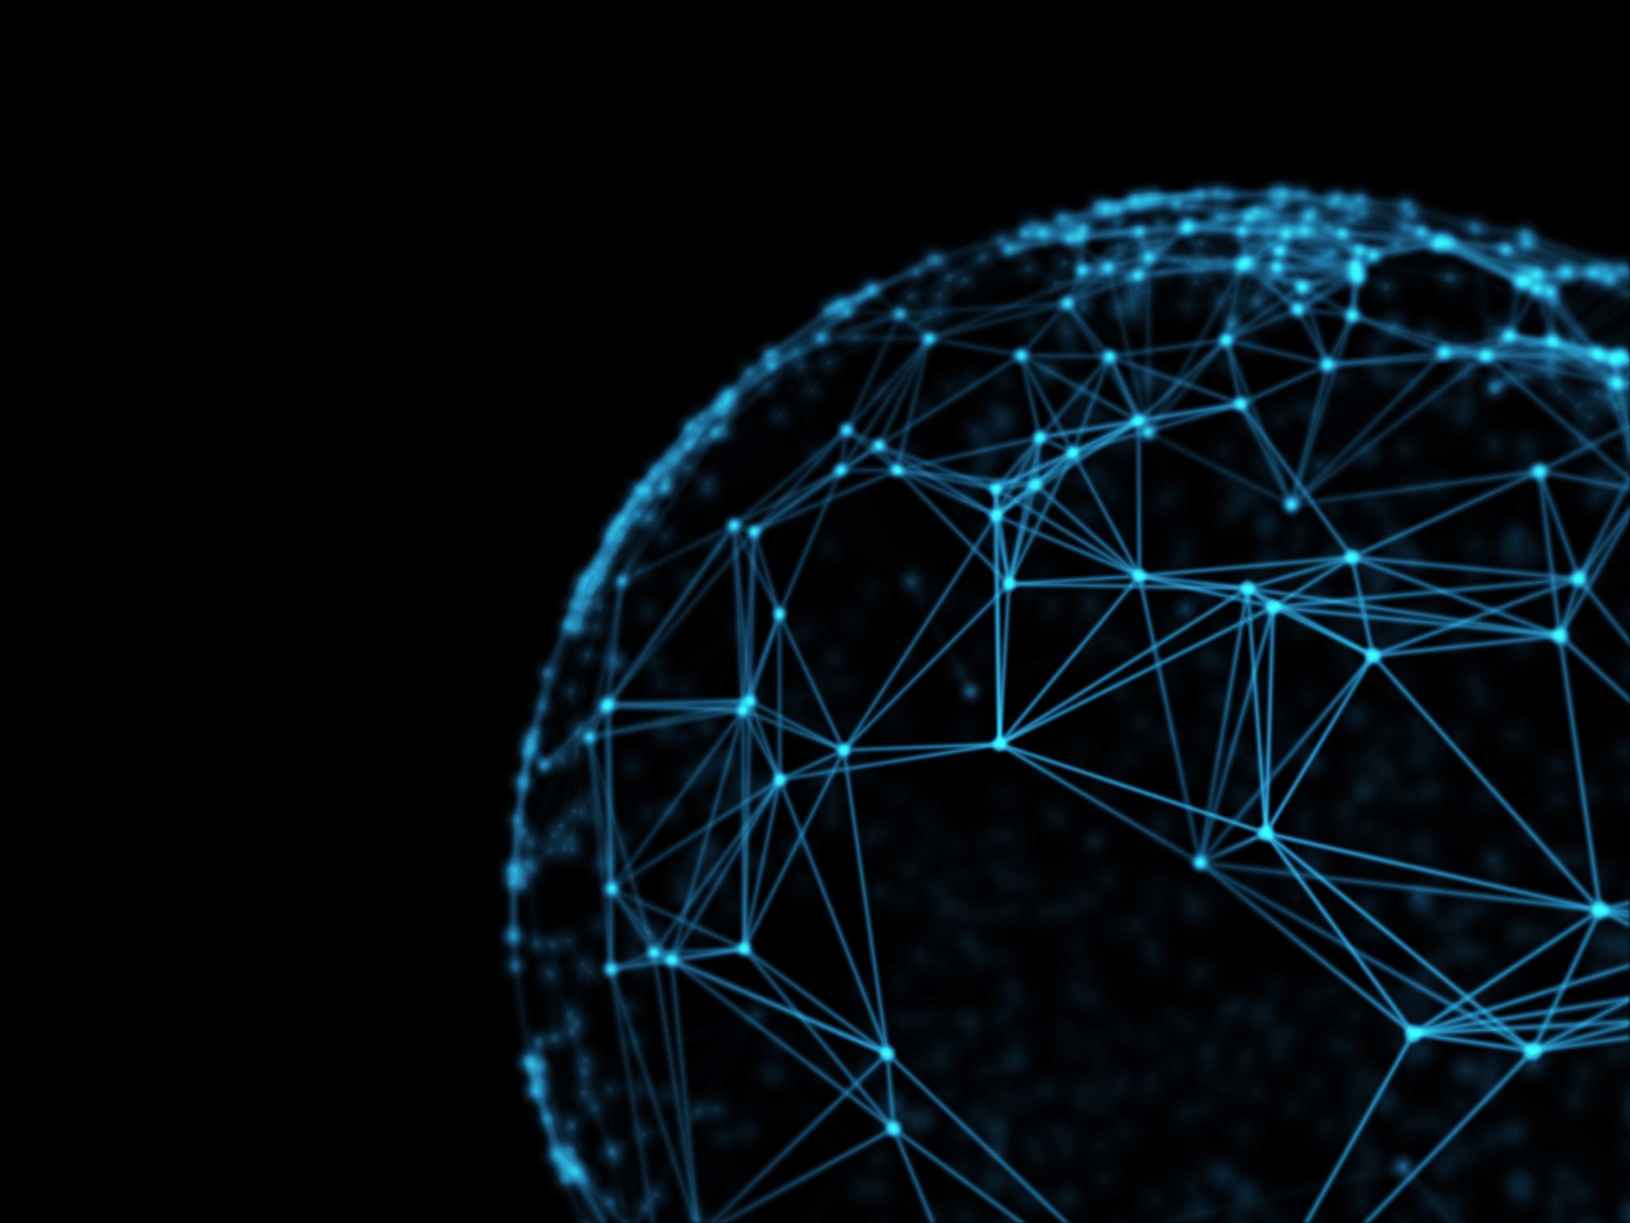
Topic 1 Market Acceptance of a New Technology Product
Event Background:
A tech company releases an innovative new product (e.g., AR glasses). The product garners widespread attention and discussion, but consumers have differing views on its functionality and practicality.
Simulation Points:
How early adopters and opinion leaders in the social network influence the public's acceptance of the new product.
The mechanisms of opinion dissemination and feedback among users.
The impact of product reviews and social media discussions on users' purchasing decisions.

Slide 5
Topic 2 Social Movements and Protests
Event Background:
A social event (e.g., unfair laws, economic inequality) triggers large-scale social movements and protests. Different groups have varying attitudes and levels of participation in the movement.
Simulation Points:
Roles and influence of protest leaders and organizers.
Information dissemination and participant mobilization in social networks.
Interactions and opinion changes among the police, government, and ordinary citizens.

Slide 6

Topic 3 Discussions on Social Welfare Policies
Event Background:
The government proposes a new social welfare policy, such as universal basic income or free healthcare. The policy triggers widespread debate and controversy in society.
Simulation Points:
Attitudes and opinion dissemination of different social groups (e.g., low-income families, middle class, wealthy individuals) towards the welfare policy.
The roles of opinion leaders and the media during policy discussions.
Dynamic changes in public opinion during policy implementation.

Slide 7
Main Method: Empower ABM with NLP
Sentiment Analysis: LLMs/NPL can perform sentiment analysis to identify emotions (such as positive, negative, neutral) in the text, helping to understand the overall emotional inclination of the public towards a particular event or topic.
Information Propagation Simulation: NLP technologies can simulate the path and speed of information spread in social networks. NLP models can analyze the content and propagation characteristics of information, predicting its reach and influence.
Virtual Interaction: In simulations, interactions between users can be implemented using NLP technologies to create natural language dialogues. This can include not only opinion exchanges but also complex interaction processes such as debates, persuasion, and consensus-building.

